Slide 1
Baby monitoring system(BMS) 22-05-2021
REVA Academy for Corporate Excellence (RACE)
Taiba Naz
MBA_05(2nd yr)
www.reva.edu.in

Slide 2
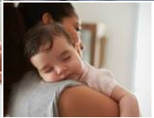
BMS:An assistance for parents
A new born brings lots of happiness in the family, but with plethora of responsibilities.
Many questions, which creates anxiety to new parents.
Does someone need to be near the baby all the time?
What if the baby needs someone and there is no one near her?
Besides babysitting, there is also some regular daily routine, which makes it impossible to carry a new born all the time.
REVA Academy for Corporate Excellence (RACE)

Slide 3
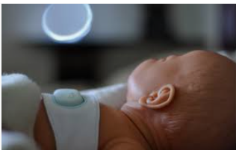
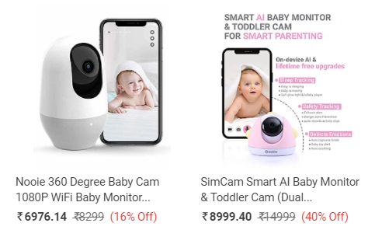
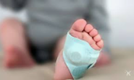
Problem with the current setup/devices
CCTV cameras cannot notify in case of emergency.
Wearable devices emits electromagnetic waves .
Most are not affordable to many of the parents.
Almost all of these detect high pitch sounds & sometimes give false alarm.
Some mobile applications are also available but all are based on sound which give alarm only when the baby is crying.
REVA Academy for Corporate Excellence (RACE)

Slide 4
Solution: The Big Idea
To design a mobile-based application, which can detect baby position in the crib/bed .
The application will notify the parents when baby needs them.
It ‘ll be able to detect whether the baby is sleeping in safe position or in hazardous position.
It ‘ll keep a record of baby sleeping pattern.
There is no hardware dependency, which make it cheaper and available for all.
Here we only need two paired mobile phones with the app installed on those phones.
REVA Academy for Corporate Excellence (RACE)

Slide 5
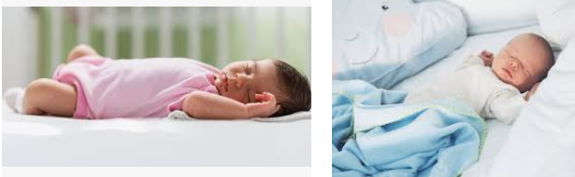
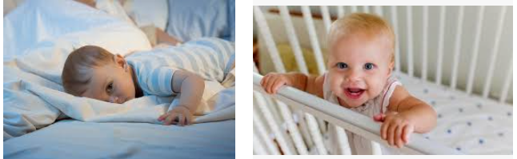
Data Collection/Understanding
Sleeping Babies
Babies waking up

Slide 6
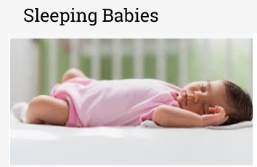
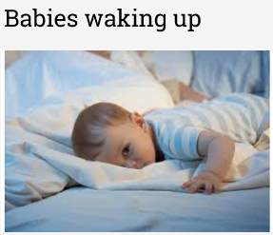
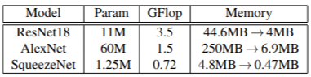
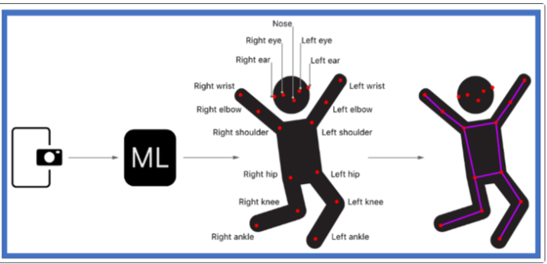
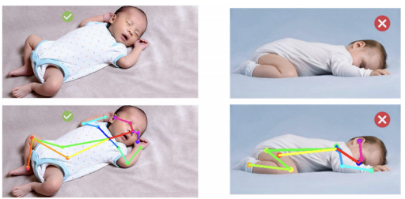
Technology Used
State of art CNN:ResNet,Alexnet,Squeezenet etc.
Posenet Model: Detect the pose by estimating the coordinates of different joints/key points.

Slide 7
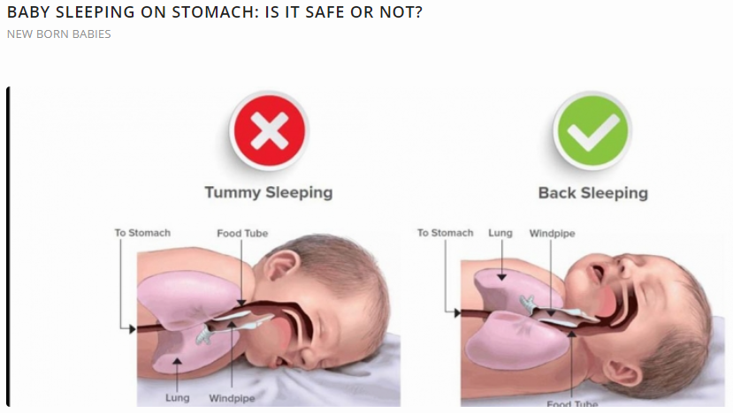
Is it Safe if Babies sleep on their Tummy?
The simple answer is no! When your baby is sleeping on the stomach that means he is breathing less in the air. This also leads to Sudden Infant Death Syndrome. This is the major reason, mothers are recommended to check their babies while sleeping. Infants should not sleep on the side either as they can easily roll to their tummies. Through the first year of the babies, pediatricians recommend laying them only on their back, which increases the airflow in the infants as well.

Slide 8

Safe Distance from crib/bed
Bed
x
y
How to detect/measure Change in position of objects in an image using ML?\
https://www.pyimagesearch.com/2016/04/04/measuring-distance-between-objects-in-an-image-with-opencv/
https://handmap.github.io/measuring-size-and-distance-opencv/

Slide 9
How to implement it in mobile app?

Slide 10
References
IoT-BBMS: Internet of Things-based baby monitoring system for smart cradle
WA Jabbar, HK Shang, SNIS Hamid… - IEEE …, 2019 - ieeexplore.ieee.org
Baby monitoring system using wireless sensor networks
G Rajesh, RA Lakshman, LH Prasad… - ICTACT Journal on …, 2014 - core.ac.uk
Baby Monitoring System using Image Processing and IoT
YK Dubey, S Damke - International Journal of Engineering and …, 2019 - researchgate.net
Design and development of a smart baby monitoring system based on Raspberry Pi and Pi camera
AF Symon, N Hassan, H Rashid… - … on Advances in …, 2017 - ieeexplore.ieee.org
Implementation of automated baby monitoring: CCBeBe Choi, Soohyun
Yun, Songho Ahn, Byeongtae 2020

Slide 11
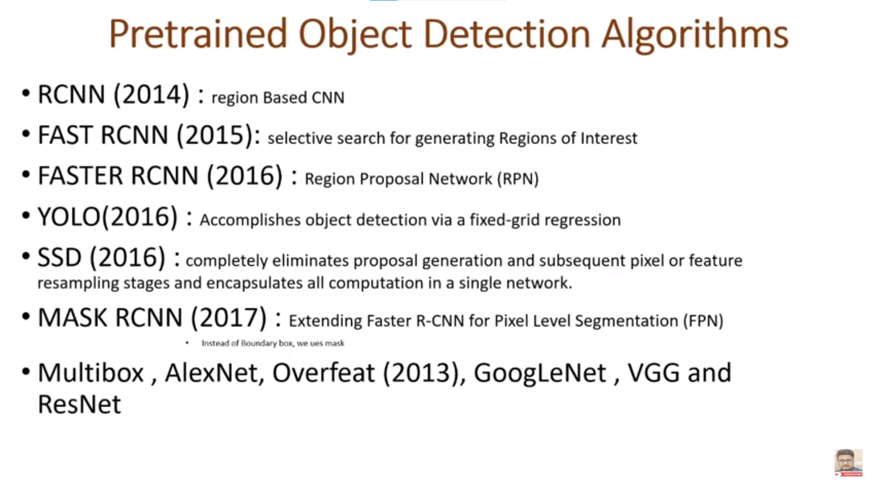

Slide 12
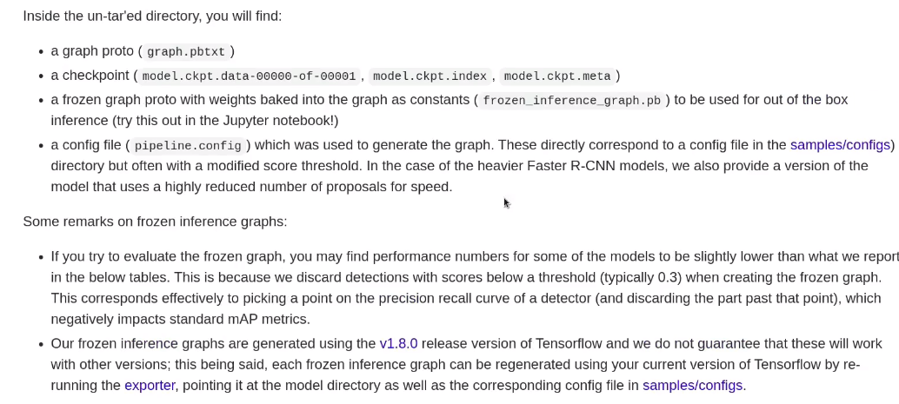

Slide 13
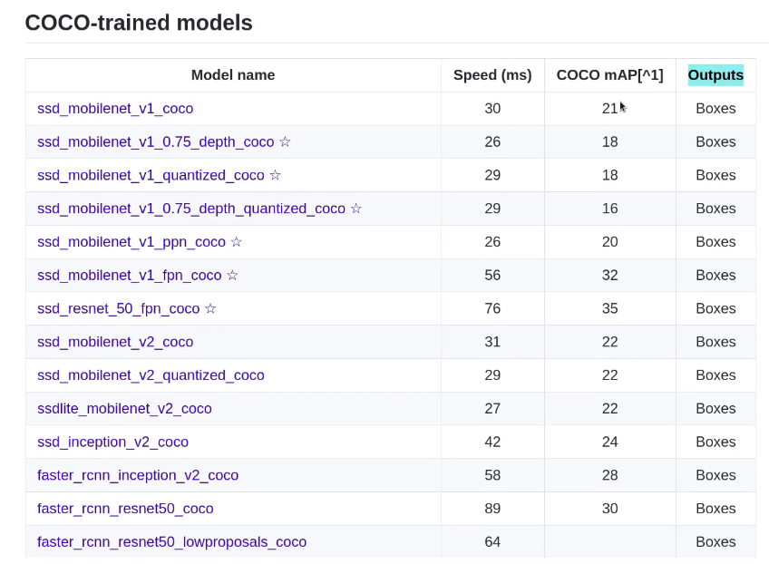

Slide 14


